Slide 1
AVAILABILITY ANALYSIS OF STEAM BOILER WITH METHANE AND AIR REACTANTS
Christabelle peter
ME 210: Advanced thermodynamics
5/6/2019

Slide 2
Case problem
Case 1:
A steam boiler is designed to convert saturated liquid water at 3500 kPa to steam at 3450 kPa and 400°C. This boiler burns methane at 1 atm and 25°C. Combustion air is also supplied at 1 atm and 25°C. The flow of combustion air is adjusted to maintain the temperature of the combustion products at 300°C. On a common basis of 1 kilogram of steam produced, calculate and plot the change in the exergy of the combustion and water streams for excess air amounts ranging from 0 to 200 percent. Also calculate and plot the exergy lost in this boiler as the excess air amount is varied.
Case 2:
Assume that an economizer (a heat exchanger that preheats the combustion air by cooling the combustion products) is added to the boiler, and thus the temperature of the combustion products is reduced to 200°C. All other factors remain the same. Air at 1 atm and 25°C passes through the economizer where it is heated before entering the boiler. Compare the loss of exergy of the economizer-boiler combination to that of the boiler only as the amount of excess air is varied.

Slide 3
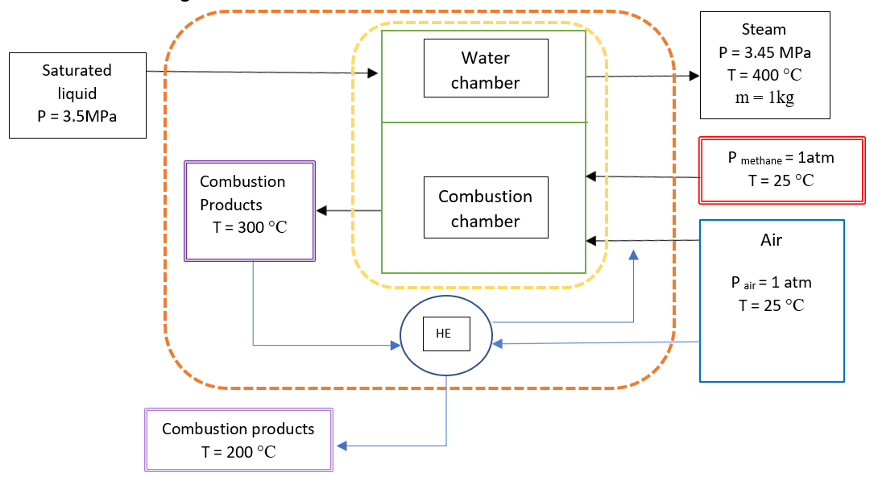
Schematic diagram

Slide 4
assumptions
Control volume shown in the figure operates at steady state
Kinetic and potential energy effects can be ignored
Combustion gases are modelled as air as an ideal gas
Boundary of the system is adiabatic
Irreversible

Slide 5
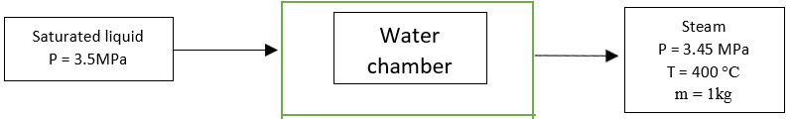
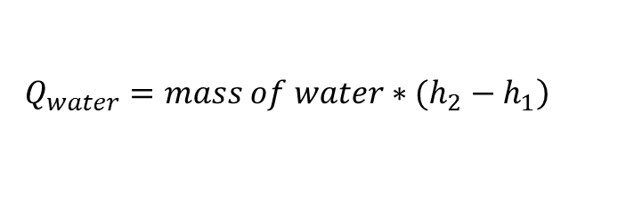
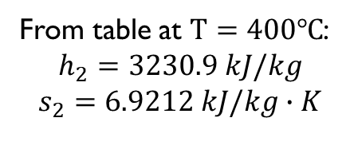
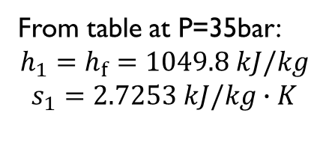
ANALYSIS
From table at P=35bar:
$${h_{1}=h}_{f}=1049.8 kJ/kg$$
$$s_{1}=2.7253 kJ/kg∙K$$
Q
From table at $T=400℃$:
$$h_{2}=3230.9 kJ/kg$$
$$s_{2}=6.9212 kJ/kg∙K$$
$$\left.Q_{water}={mass of water∗(h}_{2}−h_{1}\right)$$

Slide 6
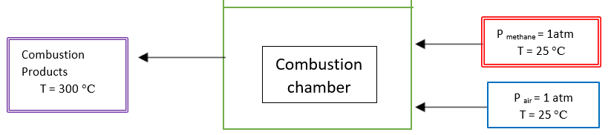
ANALYSIS
Q
$$a {CH}_{4}+b \left(O_{2}+3.75N_{2}\right) c {CO}_{2}+ d H_{2}O+e N_{2}$$
$${CH}_{4}+2 \left(O_{2}+3.75N_{2}\right) {CO}_{2}+ 2 H_{2}O+7.52 N_{2}$$
Conservation of carbon atoms: 1 = c | Conservation of oxygen atoms: 2b = 2c + d
Conservation of hydrogen atoms: 4 = 2d | Conservation of nitrogen atoms: (3.75*2)b = 2e

Slide 7
ANALYSIS
Varying amount of excess air
excess air % | 0 | 25 | 50 | 75 | 100 | 125 | 150 | 175 | 200
x | 1 | 1.25 | 1.5 | 1.75 | 2 | 2.25 | 2.5 | 2.75 | 3
${CH}_{4}+x[2 \left(O_{2}+3.75N_{2}\right)] {CO}_{2}+ 2 H_{2}O+(7.52 ∗x) N_{2}$ + ((x-1)*2) $O_{2}$

Slide 8
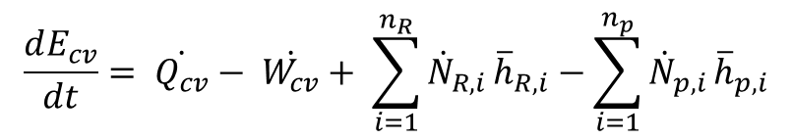
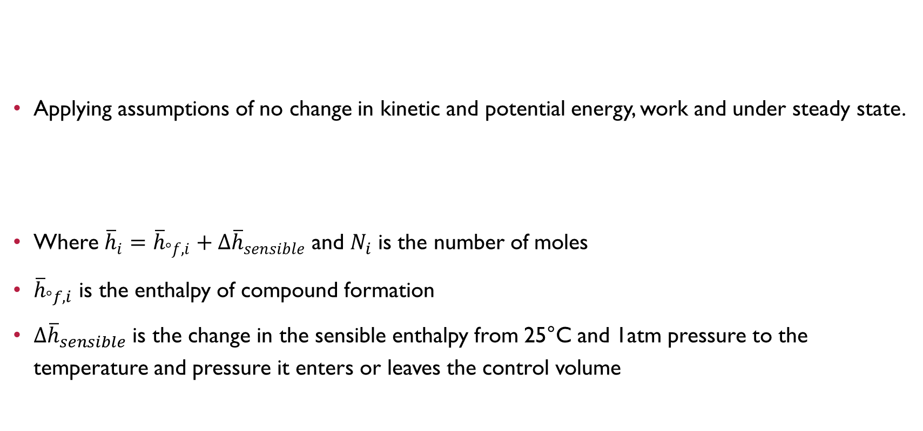
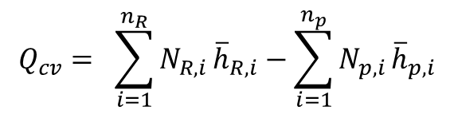
ANALYSIS
$$\frac{dE_{cv}}{dt}= \dot{Q_{cv}}− \dot{W_{cv}}+ \sum_{i=1}^{n_{R}}{{\dot{N}}_{R,i}}{\overline{h}}_{R,i}−\sum_{i=1}^{n_{p}}{{\dot{N}}_{p,i}}{\overline{h}}_{p,i}$$
Applying assumptions of no change in kinetic and potential energy, work and under steady state.
Where ${\overline{h}}_{i}={\overline{h}}_{°f,i}+∆{\overline{h}}_{sensible}$ and $N_{i}$ is the number of moles
${\overline{h}}_{°f,i}$ is the enthalpy of compound formation
$∆{\overline{h}}_{sensible}$ is the change in the sensible enthalpy from 25°C and 1atm pressure to the temperature and pressure it enters or leaves the control volume
$$Q_{cv}= \sum_{i=1}^{n_{R}}{N_{R,i}}{\overline{h}}_{R,i}−\sum_{i=1}^{n_{p}}{N_{p,i}}{\overline{h}}_{p,i}$$

Slide 9
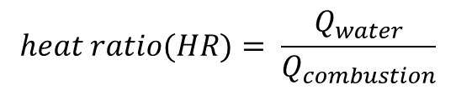
ANALYSIS
Heat produced from combustion reaction:
Change in exergy for water:
$$heat ratio(HR)= \frac{Q_{water}}{Q_{combustion}}$$
$HR∗[{ CH}_{4}+x[2 \left(O_{2}+3.75N_{2}\right)] {CO}_{2}+ 2 H_{2}O+(7.52 ∗x) N_{2}$ + ((x-1)*2) $O_{2} ]$
$${∆X_{water}=a}_{out}− a_{in}= \left( h_{2}− h_{1}\right)−T_{0}\left( s_{2}− s_{1}\right)$$

Slide 10
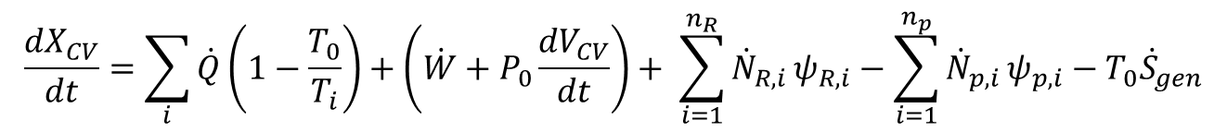
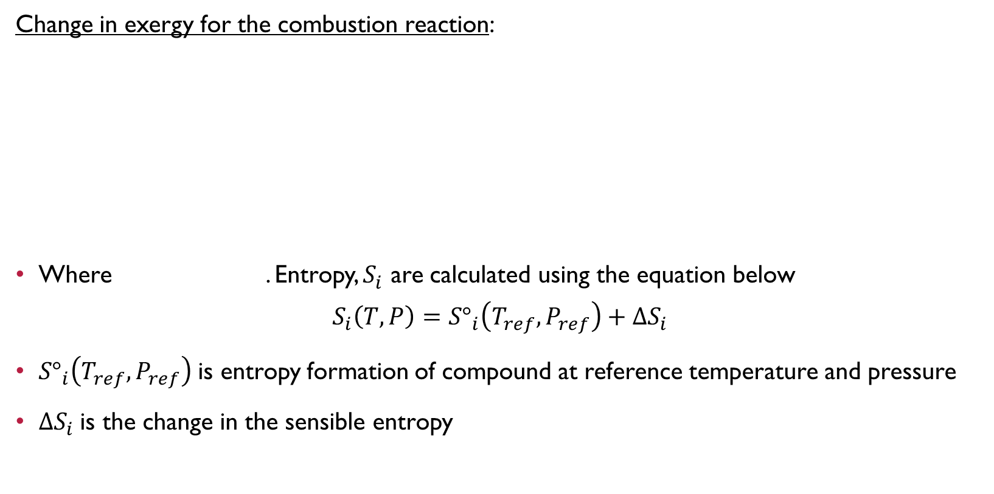

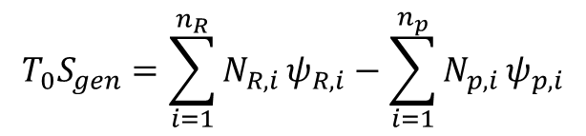
ANALYSIS
Change in exergy for the combustion reaction:
Where . Entropy, $S_{i}$ are calculated using the equation below
$$S_{i}\left(T,P\right)={S°}_{i}\left(T_{ref},P_{ref}\right)+∆S_{i}$$
${S°}_{i}\left(T_{ref},P_{ref}\right)$is entropy formation of compound at reference temperature and pressure
$∆S_{i}$is the change in the sensible entropy
$$\frac{{dX}_{CV}}{dt}=\sum_{i}{\dot{Q}}\left(1−\frac{T_{0}}{T_{i}}\right)+\left(\dot{W}+P_{0}\frac{{dV}_{CV}}{dt}\right)+ \sum_{i=1}^{n_{R}}{{\dot{N}}_{R,i}}ψ_{R,i}−\sum_{i=1}^{n_{p}}{{\dot{N}}_{p,i}}ψ_{p,i}−T_{0}{\dot{S}}_{gen}$$
$$T_{0}S_{gen}=\sum_{i=1}^{n_{R}}{N_{R,i}}ψ_{R,i}−\sum_{i=1}^{n_{p}}{N_{p,i}}ψ_{p,i}$$
$ψ_{i}=h_{i}−T_{0}S_{i}$

Slide 11
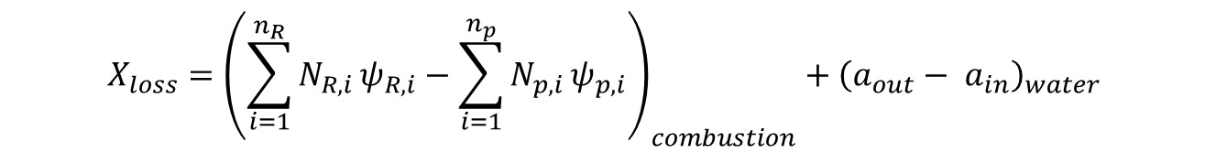

analysis
Exergy lost in this boiler as the excess air amount is varied.
Where $ψ_{i}=h_{i}−T_{0}S_{i}$ and $a_{out}− a_{in}= \left( h_{2}− h_{1}\right)−T_{0}\left( s_{2}− s_{1}\right)$
$$X_{loss}={\left(\sum_{i=1}^{n_{R}}{N_{R,i}}ψ_{R,i}−\sum_{i=1}^{n_{p}}{N_{p,i}}ψ_{p,i}\right)}_{combustion}+{\left(a_{out}− a_{in}\right)}_{water}$$

Slide 12
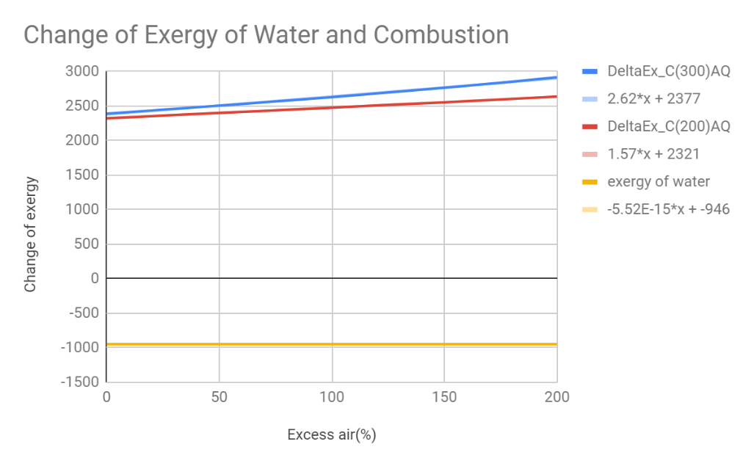
RESULTS for change of exergy

Slide 13
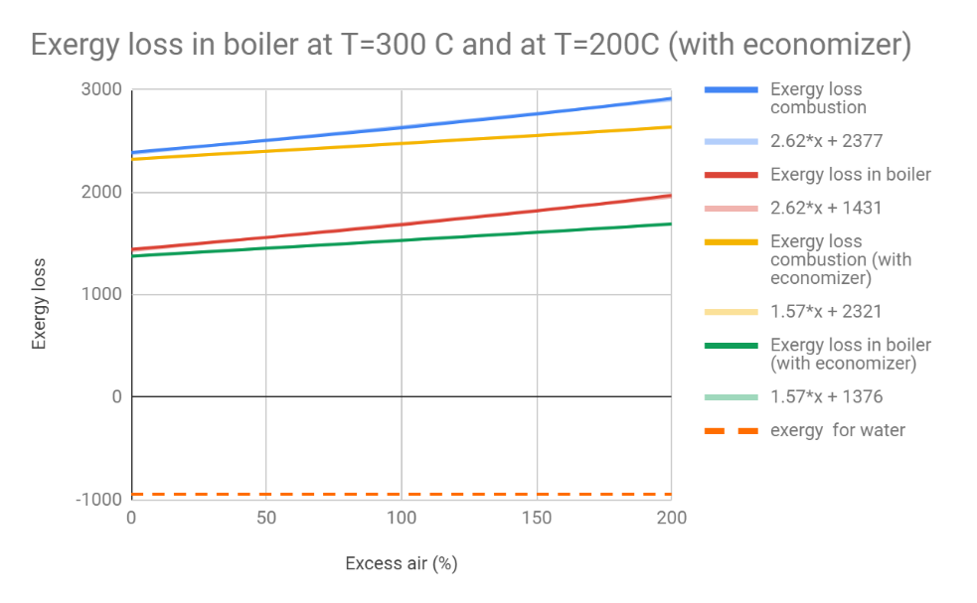
RESULTS for exergy loss

Slide 14
conclusion
Increasing excess air, will increase the exergy loss in the boiler as some of the heat is used to heat up the air
Heat transfer of the combustion process cannot be eliminated and thus produces exergy loss. Thus, with the economizer, it helps to reduce the exergy loss because the thermal energy from the combustion are used to heat up the incoming air.
The economizer can be improved by having better combustion control in excess air and better inlet air preheating.

Slide 15
REFERENCE
MORAN, MICHAEL J. FUNDAMENTALS OF ENGINEERING THERMODYNAMICS. JOHN WILEY &amp; SONS, 1988.

